Slide 1
Unit 2 Continue…
SEPM ,
By
Dr. ram Kumar

Slide 2
Design Concept Chapter 8 , R S Pressman

Slide 3
The goal of design
The Roman architecture critic Vitruvius advanced the notion that well-designed buildings were those which exhibited firmness, commodity, and delight. The same might be said of good software.
Firmness: A program should not have any bugs that inhibit its function.
Commodity: A program should be suitable for the purposes for which it was intended.
Delight: The experience of using the program should be a pleasurable one.

Slide 4
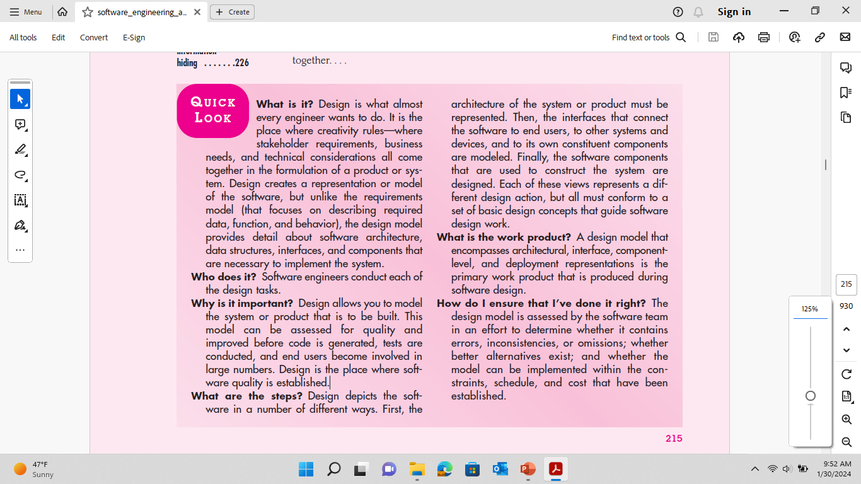

Slide 5
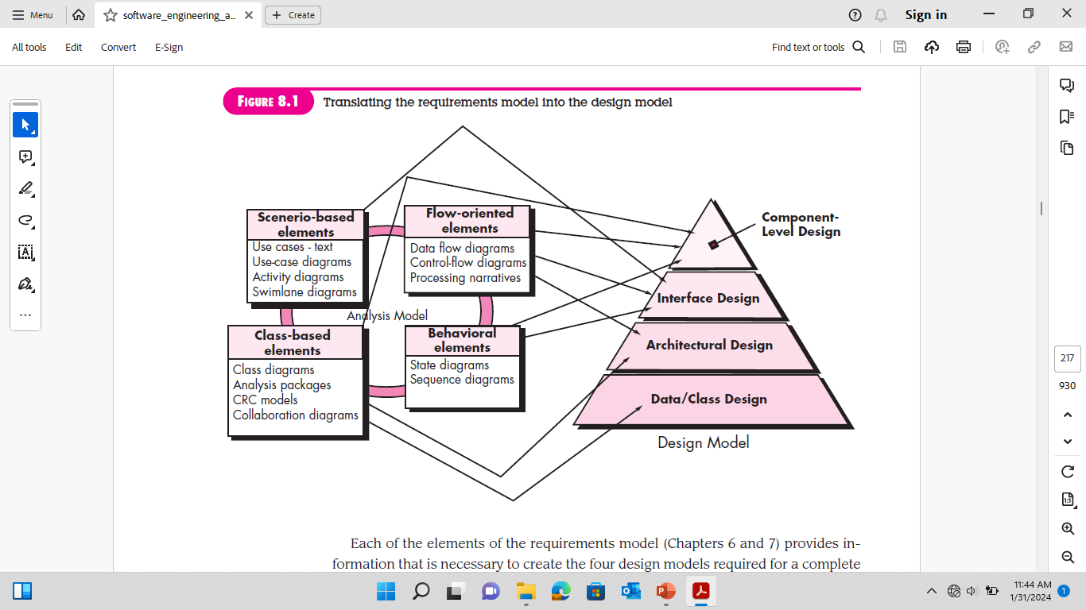

Slide 6
